Slide 1
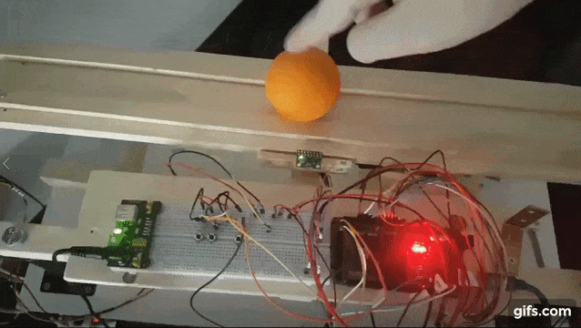
Balance Control of a Ball
Pedro Rossa nº87344

Slide 2
Introdution
SAD – 2019/2020
The objective of this project is to balance a ball on a platform (1D movement) and if the ball is moved to a different position which is not the middle (by default de desired position) of the board the machine should return it to the middle.

Slide 3
List of Components
SAD – 2019/2020
Ardunio MEGA 2560;
Breadboard;
SG90 Servo;
Buttons;
Sensors:
GY-521/MPU-6050 (Accelerometer and gyroscope module 3 axes) ;
HC-SR04 (Sonar);
HDSP-B0xE (4 digit seven 7 display);

Slide 4
SAD – 2019/2020
Build the support for the gondola
Testing the Hardware
Motor working
Designing the code to control the motor with the Gyro. data
Start
Gyroscope and Accelerometer
Assembling all the components.
Errors found
Testing for error.
Learning the Arduino
END

Slide 5
SAD – 2019/2020
Build the support for the gondola
Testing the Hardware
Motor working
Designing the code to control the motor with the Sonar data
Start
Sonar
Assembling all the components.
Errors found
Gyroscope and Accelerometer
Testing for error.
Learning the Arduino
Send the information to the display.
END

Slide 6
MPU-6050 (Acce. and gyroscope module 3 axes)
SAD – 2019/2020
This sensor uses I2C, so you have to connect the SDA and the SCL to the Arduino port's SDA and SCL, in this case the Arduino is the master and controls the MPU-6050, to facilitate this part of programming it was used the library Wire to handle the buffers.
Procedure:
Send a start sequence
Send I2C address of the device with the R/W bit low (evenaddress)
Send the Internal register address
Send a start sequence again (repeated start)
Send the I2C address of the device with the R/W bit high(odd address)
Read data byte from the register
Send the stop sequence.
Arduino | MPU-6050
5V | Vcc
Ground | Ground
SDA | SDA
SCL | SCL

Slide 7
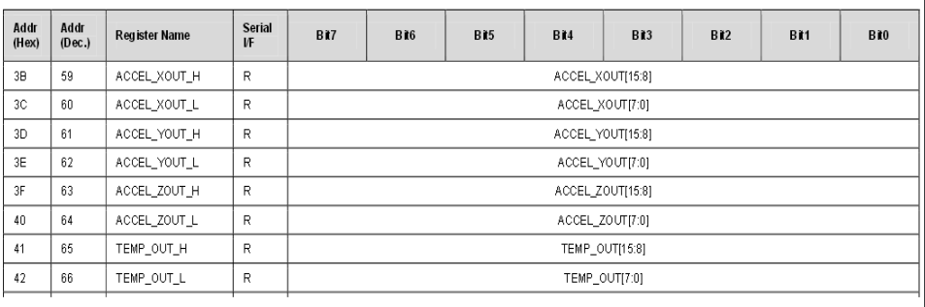
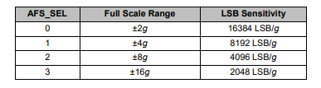
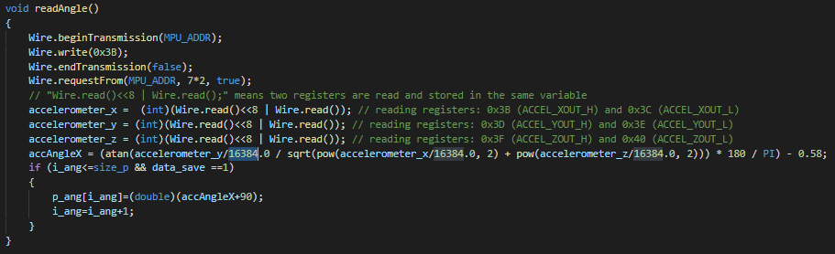
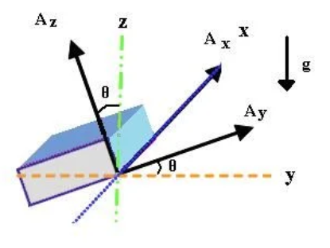
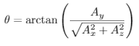
MPU-6050 (Acce. and gyroscope module 3 axes)

Slide 8
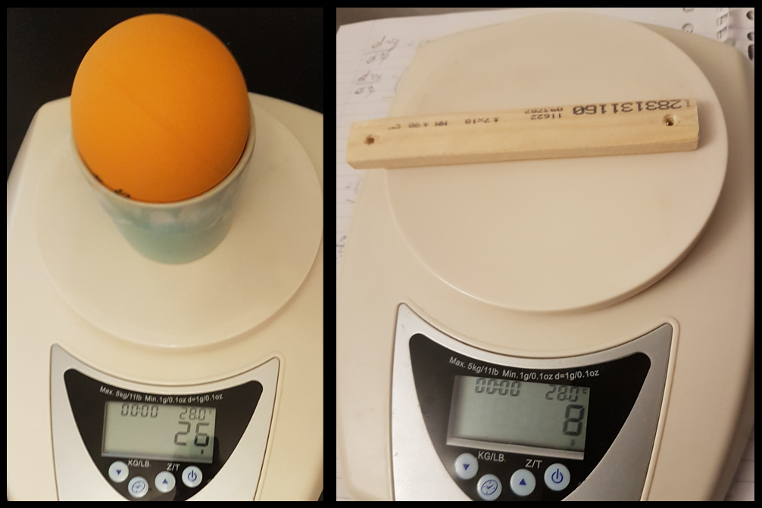
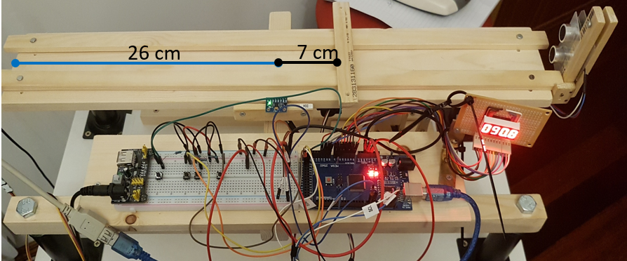

SG90 (Servo motor)
SAD – 2019/2020
Frist think it was done was making sure the servo can move the platform to do that it was calculated the torque that the motor needed to do to cancel the one generated by the ball at the end of the platform:
Since the board is not in equilibrium due to the sensor binning attached to the end of it, I calculated this extra torque by putting a weight in a position such as the platform is in equilibrium:
$$T=W∗g∗d$$
-3
Tres = 5.4936x10 N.m
Arduino | SG90
5V | Vcc
Ground | Ground
PH7 | Signal

Slide 9
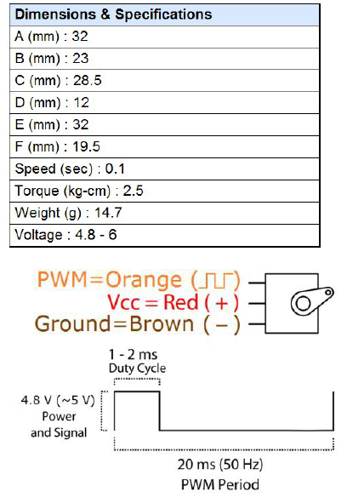
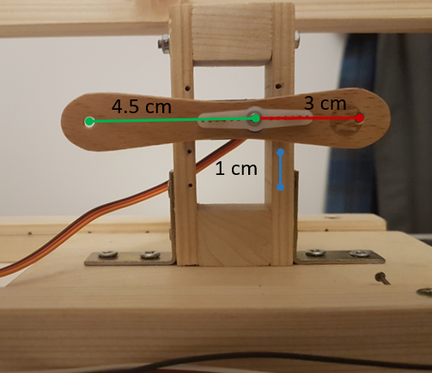
SG90 (Servo motor)
SAD – 2019/2020
Them it was calculated the torque with the ball at the end of the platform:
Tball_right = 0.0608 N.m
Tball_left = 0.0718 N.m
By checking in the datasheet the servo motor SG90 was a torque of 2.5 kg-cm this mean that the motor will stall when a weight of 2.5 kg it is hanging from a 1 cm long arm that is attached to the motor spindle,
so since the motor was a arm of 3 cm the maximum wight that the motor can move is 0.833 kg.
Arduino | SG90
5V | Vcc
Ground | Ground
PH7 | Signal

Slide 10
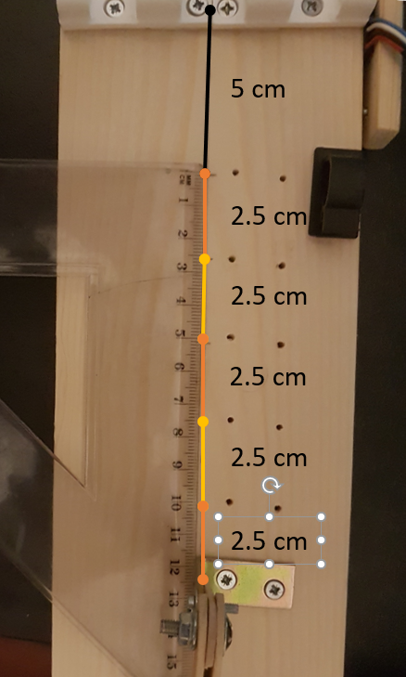
SG90 (Servo motor)
SAD – 2019/2020
Tball_right = 0.0608 N.m
Tball_left = 0.0718 N.m
-2
-2
0.0608/((26-17)x10 x9.81)=0.069 kg.
0.0718/((26-17)x10 x9.81)=0.081 kg.
Maximum = 0.833 kg
Arduino | SG90
5V | Vcc
Ground | Ground
PH7 | Signal

Slide 11
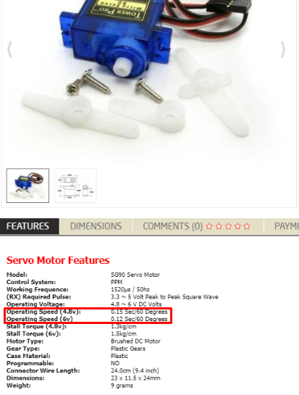
SG90 (Servo motor)
SAD – 2019/2020
The implementation of the controller of the servo was done via the library Servo because when it was been programming the PWM to move the servo, it was not working and later it was found an extra information that could help debug the code.
Arduino | SG90
5V | Vcc
Ground | Ground
PH7 | Signal

Slide 12
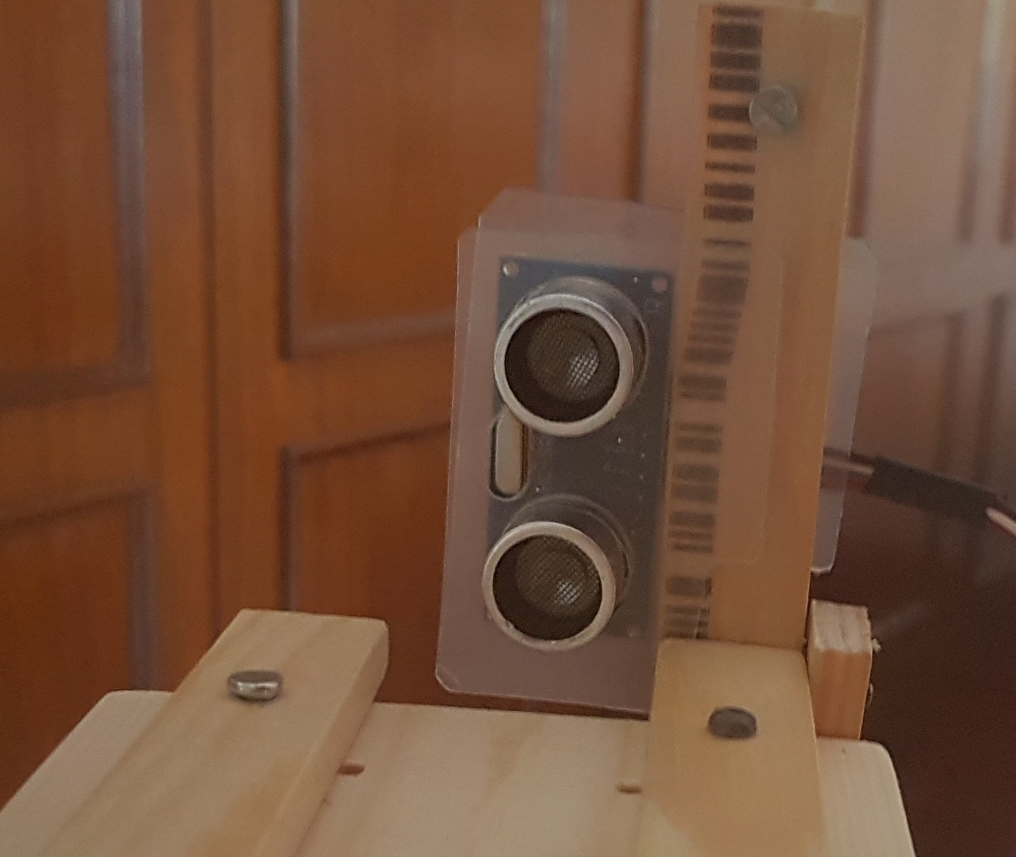
HC-SR04 (Sonar)
SAD – 2019/2020
The Trigger pin must be supplied a short 10uS pulse to start the ranging and wait 60 ms, for the wave has time to travel back to the sensor before sending another pulse, and then the module will send out an 8 cycle burst of ultrasound at 40 kHz.
Arduino | HC-SR04
5V | Vcc
Ground | Ground
PH6 | Trigger
PL0 (ICP4) | Echo

Slide 13
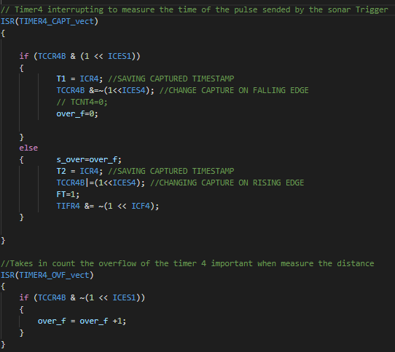
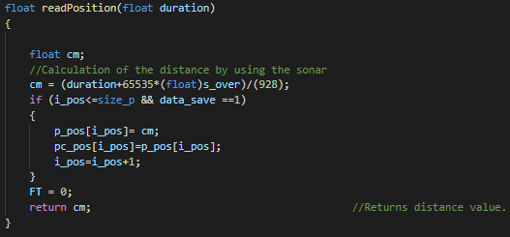
HC-SR04 (Sonar)
SAD – 2019/2020
The Echo pin should be connected to an input pin of the microcontroller, because in this pin after the wave is reflected on the ball it goes high for a particular amount of time, which will be equal to the time taken for the wave to return back to the sensor.
The Input Capture is sensitive to rising flanks because it is expected to be the beam of the reflected wave. Then the time of the ICR4 is saved in a variable (in this case T1) and then the sensing mode is changed to falling flank waiting for the wave ends and again saving the time in a variable (T2).
Arduino | HC-SR04
5V | Vcc
Ground | Ground
PH6 | Trigger
PL0 (ICP4) | Echo
duration = T2-T1+65535*s_over
distance= duration/(29 * 2 * 16)
= duration/928 [cm]

Slide 14
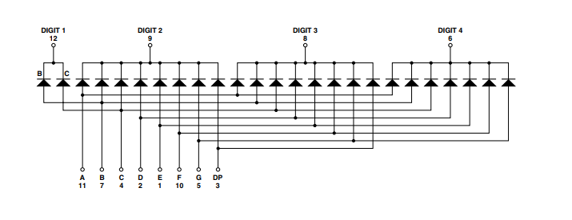
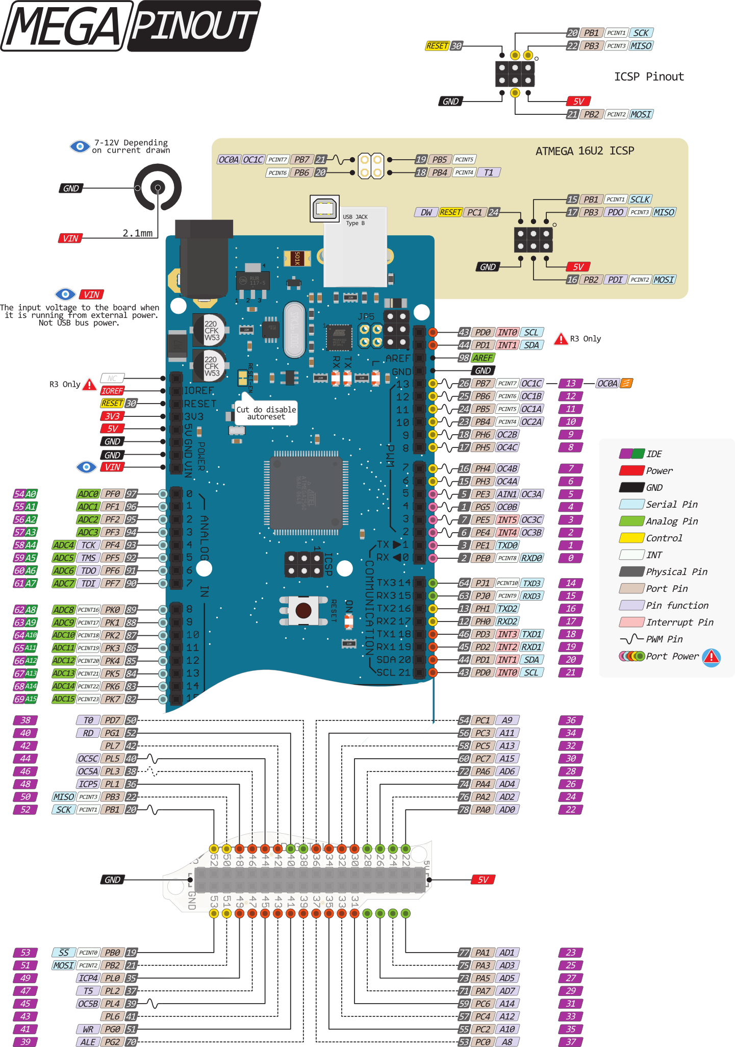
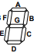
HDSP-B0xE (4 digit 7 segment display)
SAD – 2019/2020
Arduino | 4 digit 7 segment led
PF0 | DP (3)
PF1 | G (5)
PF2 | F (10)
PF3 | E (1)
PF4 | D (2)
PF5 | C (4)
PF6 | B (7)
PF7 | A (11)
PK0 | Digit 4 (6)
PK1 | Digit 2 (8)
PK2 | Digit 3 (9)
PK3 | Digit 1 (12)

Slide 15
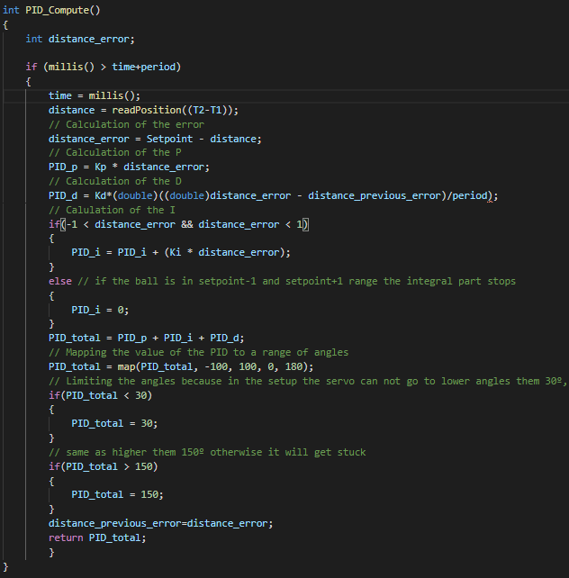
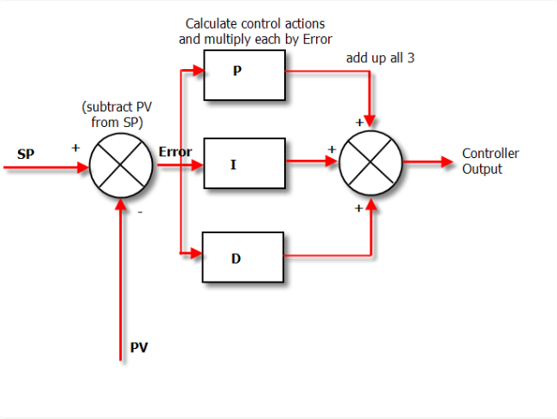
Control: PID (Proportional–Integral–Derivative)
Continuously calculates an error value as the difference between a desired setpoint (SP), in this case is the position that we want the ball, and a measured process variable (PV) and applies a correction based on proportional, integral, and derivative terms (denoted P, I, and D respectively), hence the name.

Slide 16
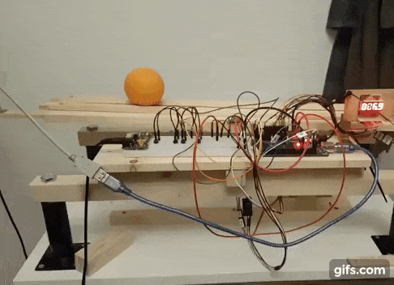
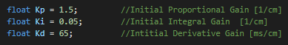
Tuning PID
SAD – 2019/2020
To tuned the PID I started all values at 0 of Kp, Kd, and Ki and increased the Kp gain until the response to a disturbance is steady oscillation and the ball is contained on the platform, then increase the Kd gain until the oscillations go away, it's critically damped,
and then I increase the Ki gain until the situation that the system stabilizes the platform when it stops the ball after moving it to the setpoint.

Slide 17
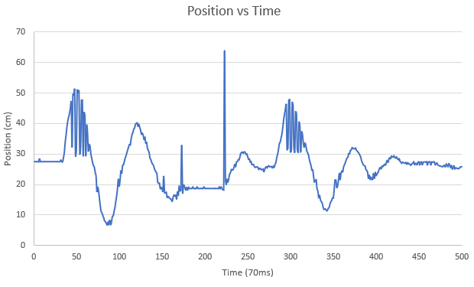
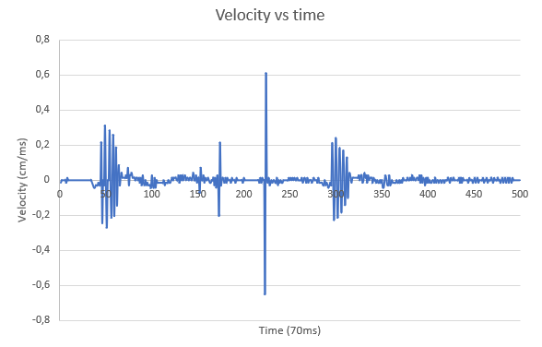
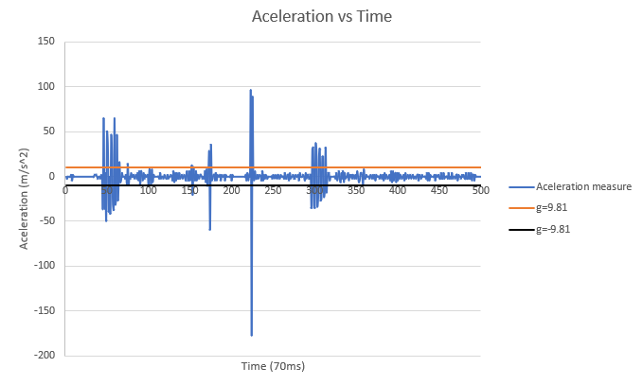
PID
SAD – 2019/2020
At this point I started doing some test to see if the machine was doing every thing as expected:

Slide 18
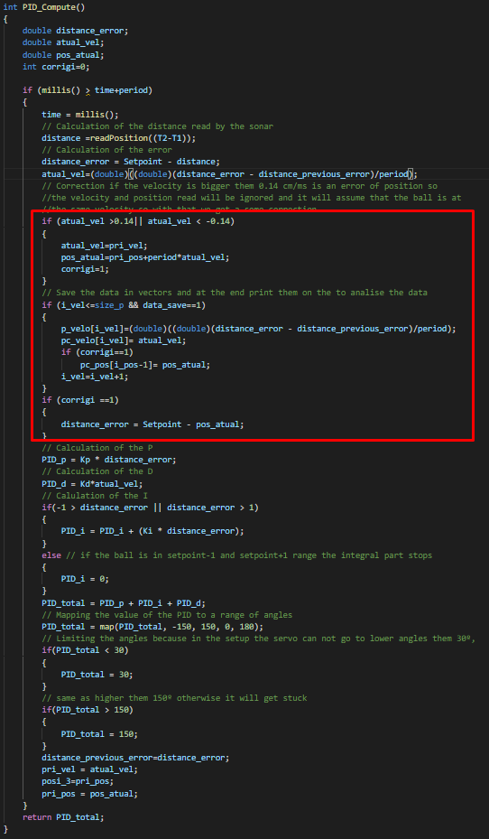
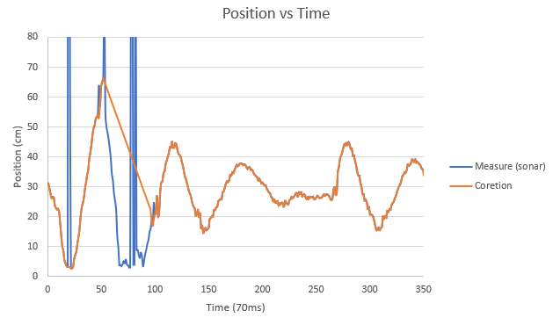
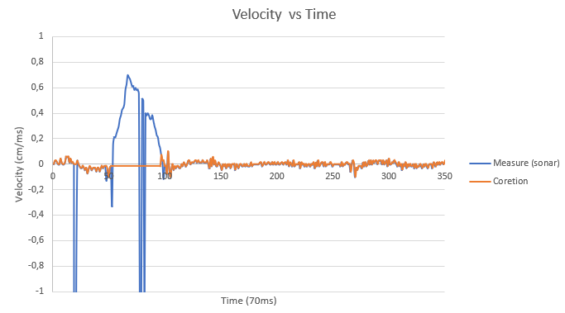
PID
SAD – 2019/2020
So it was introduced a way to reduce this miss read position:

Slide 19
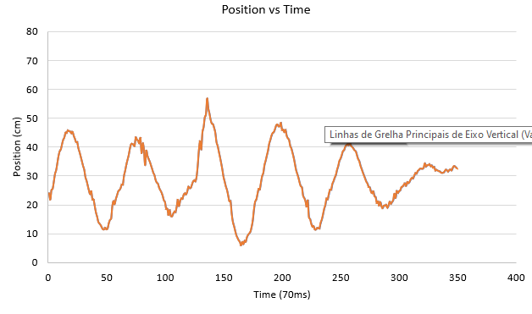
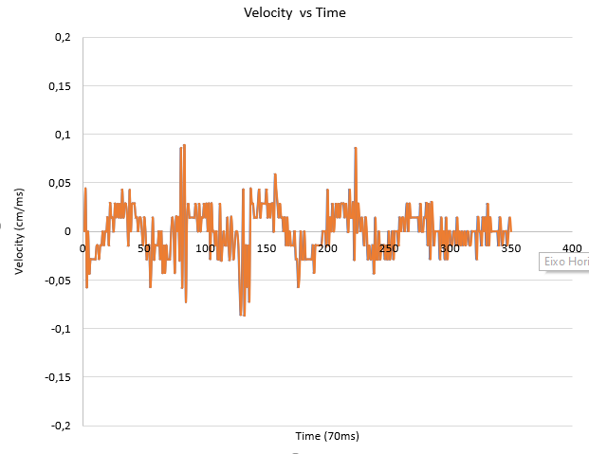
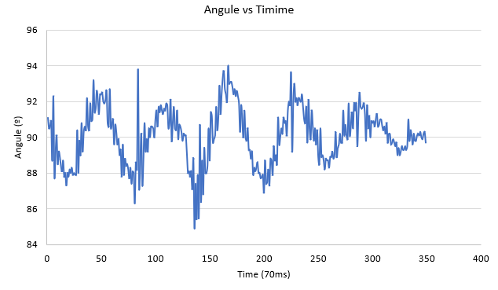
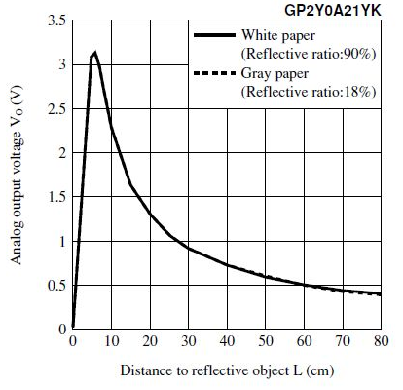
Conclusion
SAD – 2019/2020
The project was successfully carried out with all the similarities made, the bullet returned to its intended position. There are small problems when the ball moves too far away from the sonar, which is to be expected due to the spherical shape of the wave, which is difficult to reflect the wave, this is the reason why we had errors in reading the position of the ball.
A solution that could be applied in the future will be to replace the sonar with the GP2Y0A21YK sensor, which is an infrared proximity sensor, which can measure distances between 10-80 cm, so the only care we should take is placing it 10 cm off the platform.
Week | Time spend | Doing
[04/05-11/05] | 6h | Wood Working and modelling
[10/05-15/05] | 7h | Servo and MPU-6050 coding
[22/06-25/06] | 10h | Sonar and Display
[29/06-03/07] | 10h | Debugging code and PDI
[20/07-25/07] | 5h | Debugging code

